Slide 1
Threading in Parrot
Stefan “nine” Seifert

Slide 2
This talk
Introduction
Existing solutions
Green Threads
Hybrid Threads
Implementation
Results
Notes:
questions? feel free to interrupt!

Slide 3
Who has used threading in Perl 5?
Notes:
quick show of hands
Are you thorougly satisfied?

Slide 4
Threading in Perl 5
5.005 threads
  everything shared
  unstable
  unfixable problems
Notes:
deprecated
regex match variables shared
mysterious crashes
even read access may write to variables
protect variables by locks
guarantee the same for all loaded modules?

Slide 5
Threading in Perl 5
ithreads
  explicit sharing
  easy to use
  terrible performance
Notes:
introduced in 5.6
side effect of x-platform support
emulation of fork() for Windows
API exposed 5.8
starting threads takes ages
writes are very slow

Slide 6
What's so difficult about threads?

Slide 7
Method calls:
$foo->bar();
$foo->bar();
Notes:
static language:
compiler knows much
follow pointer to vtable
fixed slot for method
call!

Slide 8
Method call
Fetch foo's class
Fetch meta class
Fetch method
Call method
Notes:
with threads:
everything may change anytime
5 different locks for every method call?

Slide 9
Threading in Python
Global Interpreter Lock
Notes:
lock for every op
threading, but no performance win
used for I/O
In Perl we use async frameworks

Slide 10

Notes:
Compiler/Runtime
Perl 6 runtime split off
because of unfinished spec
Parrot VM
RFC #1 threading support
threading removed about a year ago

Slide 11
Green Threads
Tasks
Managed by the interpreter
Preemption
Use only 1 CPU core
Notes:
user space threads
interpreter contains scheduler and preemption
switches tasks based on timer
interpreter knows exactly when tasks are switched

Slide 12
Hybrid Threads
Worker threads
Variable is owned by exactly one thread
Read by all threads
Write by the owner thread
Tasks as messages
Explicit sharing

Slide 13
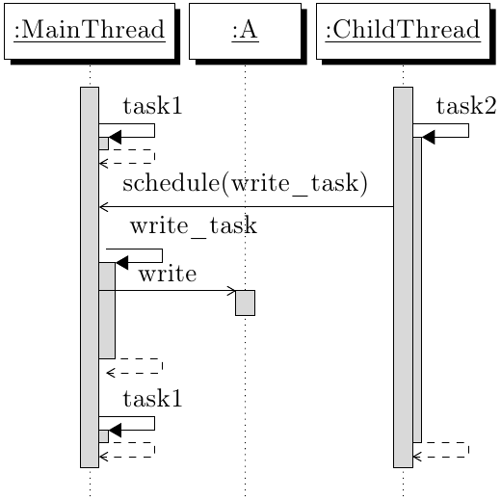
Writing to foreign variable

Slide 14
Example message
.sub write_task
.param pmc variable
variable = 1
.end

Slide 15
Example using task
function main() {
var print_code = printer;
var a = new 'Task';
a.code = print_code;
a.data = 'a';
var b = new 'Task';
b.code = print_code;
b.data = 'b';
${schedule a};
${schedule b};
sleep(5);
say();
exit(0);
}
function printer(var name) {
while (1) {
print(name);
sleep(0.1);
}
}

Slide 16
Implementation
Scheduler
Timer
Proxies
GC
Notes:
Scheduler: task queue, loop executing tasks
Timer: timer thread

Slide 17
Scheduler
task queue
outer runloop
preemption

Slide 18
Timer
It's own thread
Only really handles one alarm
Notifies threads on expiry

Slide 19
Garbage Collector
1 GC per thread
More locks than anticipated

Slide 20
Proxies
Created for shared variables
Pass on read calls
Creates proxy for results
Exception on write

Slide 21
Results
Fully implemented
Hopefully in the next parrot release
Performance dependent on R/W ratio

Slide 22

Mandelbrot calculation
Notes:
scales almost linearliy up to 4 threads
only 4 CPU cores + hyper threading
Mandelbrot is embarassingly parallel

Slide 23
Thank you very much!
http://www.parrot.org
Notes:
Not bragging, but:
did all this without any prior experience with Parrot!
Parrot extremely nice and approachable community
Much help

